Slide 1
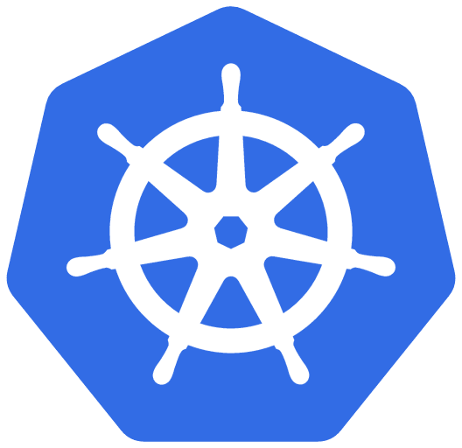
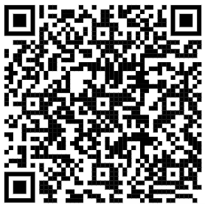


Implementing AKS on the Enterprise
Jorge Arteiro @JorgeArteiro
Senior Developer Advocate at Microsoft – Cloud Native and Containers
Vic Perdana @vperdana
Partner Solution Architect at Microsoft

Slide 2
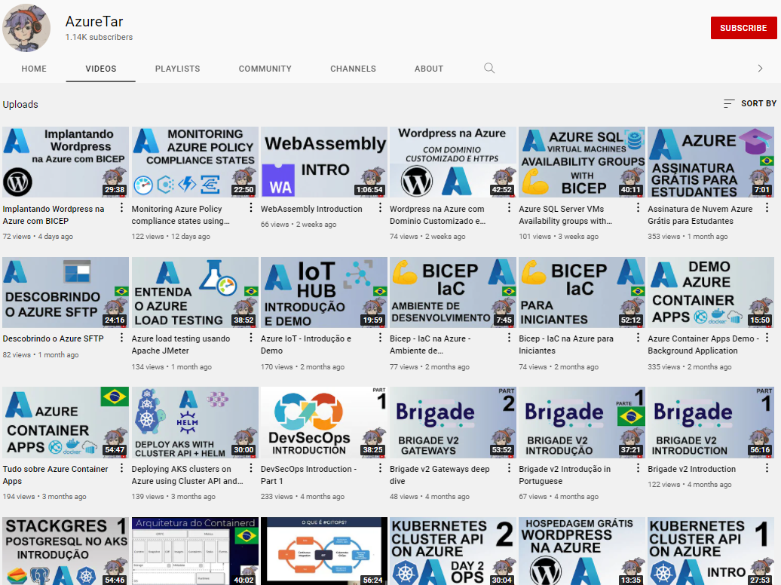


AzureTar.com @AzureTar
youtube.com/AzureTar
Cloud Computing Science - From Abstraction to Invention changing the way we communicate, learn, solve problems and do business
https://youtube.com/AzureTar

Slide 3
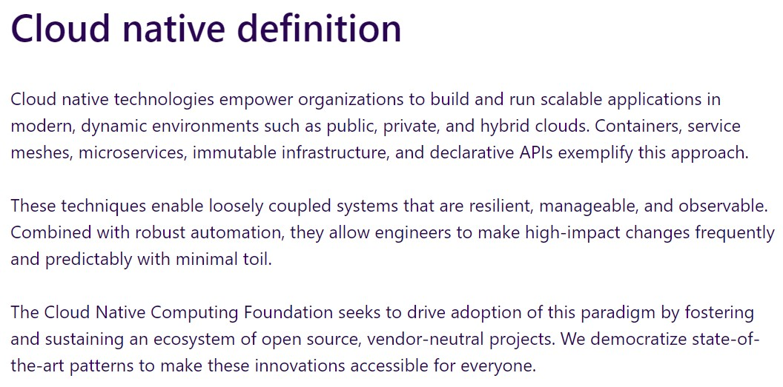
What’s Cloud Native
https://cncf.io

Slide 4


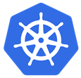









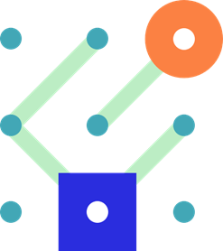


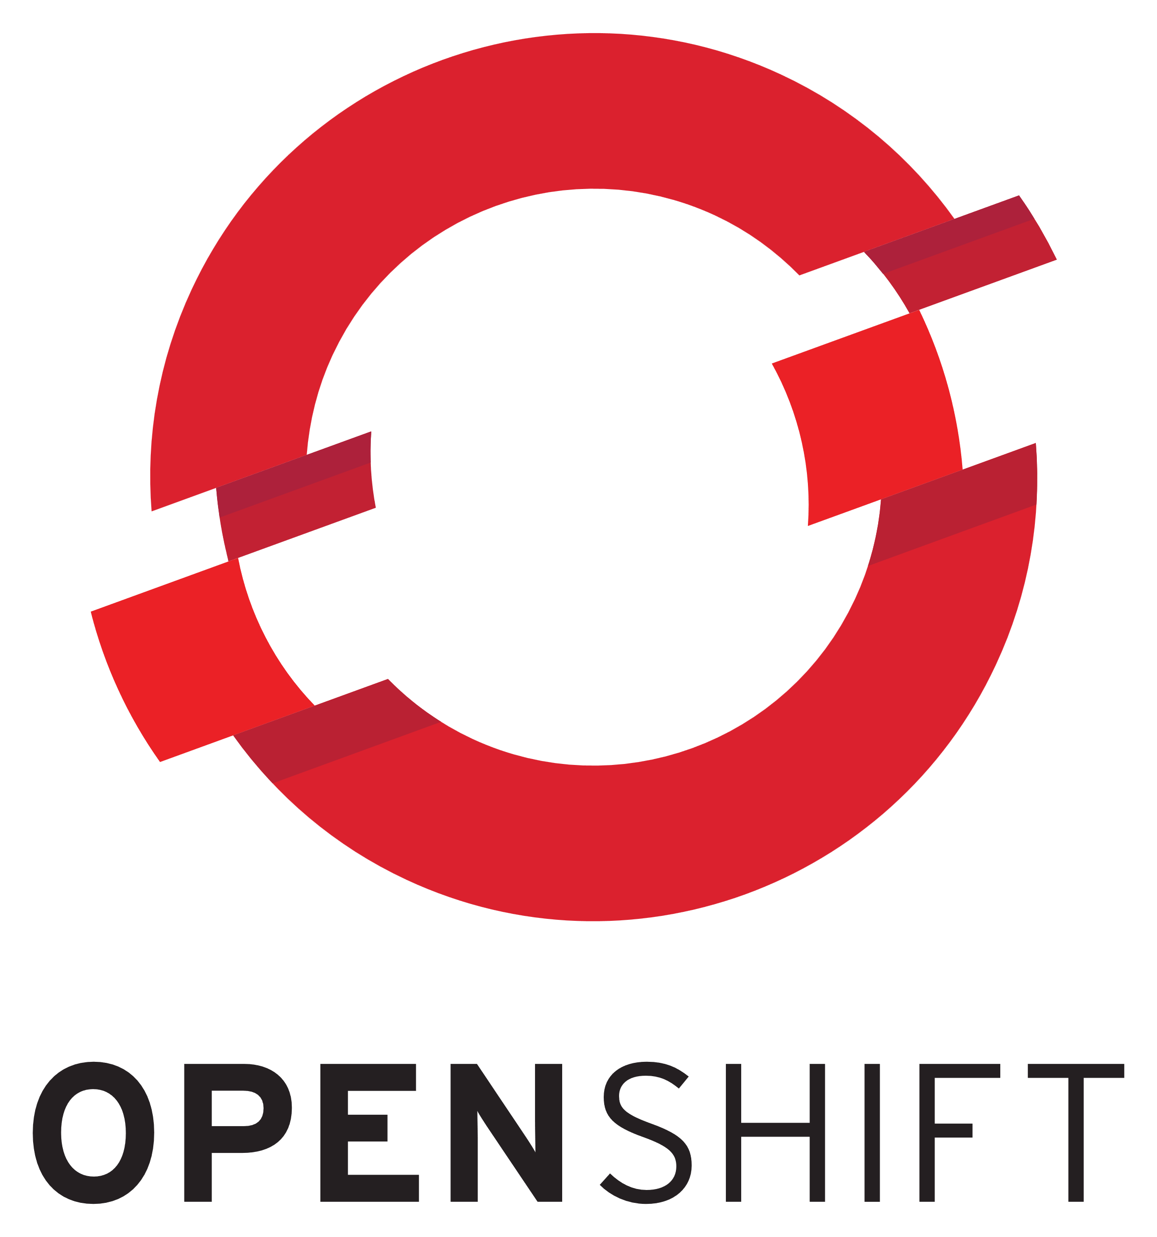











Cloud-native on Azure
01-02
Community
Security
AI
Active Directory
Azure Policy
Microsoft Defender
Key Vault
Azure Advisor
Vision
Speech
Language
Decision
Development tools
Cloud-native application platform
Managed databases
GitHub
Azure Kubernetes Service
Azure Red Hat OpenShift
Azure Container Apps
Azure Functions
Azure PostgreSQL
Azure Cosmos DB
Azure SQL family
Azure MySQL & MariaDB
Visual Studio Code
Azure API Management
Azure Container Registry
Cloud operations anywhere
Azure Arc

Slide 5
Common cloud-native scenarios
Modernize business critical applications
SaaS delivery
Real-time telemetry
Geo-distributed applications
Run applications anywhere
AI-powered apps
Notes:
Now, let’s talk about some of the common scenarios for cloud-native apps

Slide 6
Azure Kubernetes Services

Slide 7
Kubernetes
is complex
Agent pools
User
Agent node
kubelet
kube-proxy
Internet
Kubernetes users communicate with API server and apply desired state
Control plane
Container runtime
Control plane actively enforces desired state on agent nodes
api-server
Pods
Pods
Containers
Containers
Agent nodes support communication between containers
controller-manager
scheduler
Agent node
kubelet
kube-proxy
Internet
Agent nodes support communication from the Internet
replication, namespace, serviceaccounts, etc.
etcd
Container runtime
Pods
Pods
Agent pools keep multiple agent nodes organized
Containers
Containers

Slide 8
Managed
Kubernetes
handles the complexity for you
Automated upgrades, patches
High reliability, availability
Azure managed control plane
Agent nodes
Control plane
-controller-manager
Container runtime
Easy, secure cluster scaling
api-server
-scheduler
Pods
Pods
Self-healing
Containers
Containers
API server monitoring
Container runtime
At no charge*
etcd
Pods
Pods
Containers
Containers
*Higher SLA guarantees available as an optional uptime SLA paid feature

Slide 9
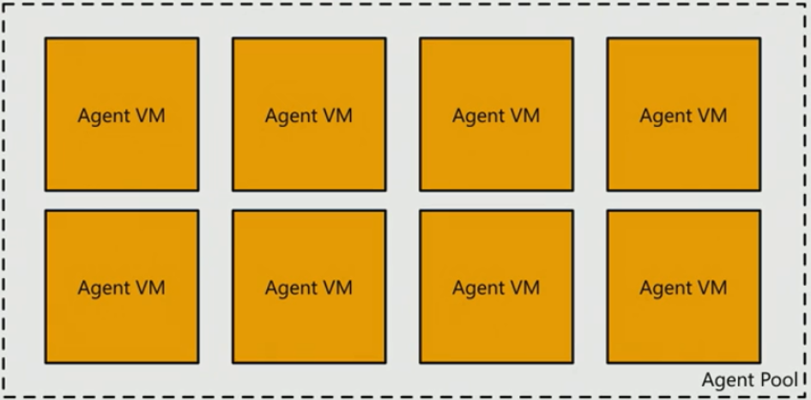
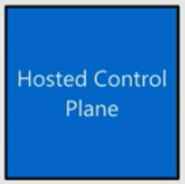
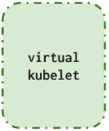
AKS Node Pools – Multi-platform
Linux
Windows
Wasm
Arm64
GPU
Isolated
ACI
ACI
Confidential
Linux
Windows

Slide 10
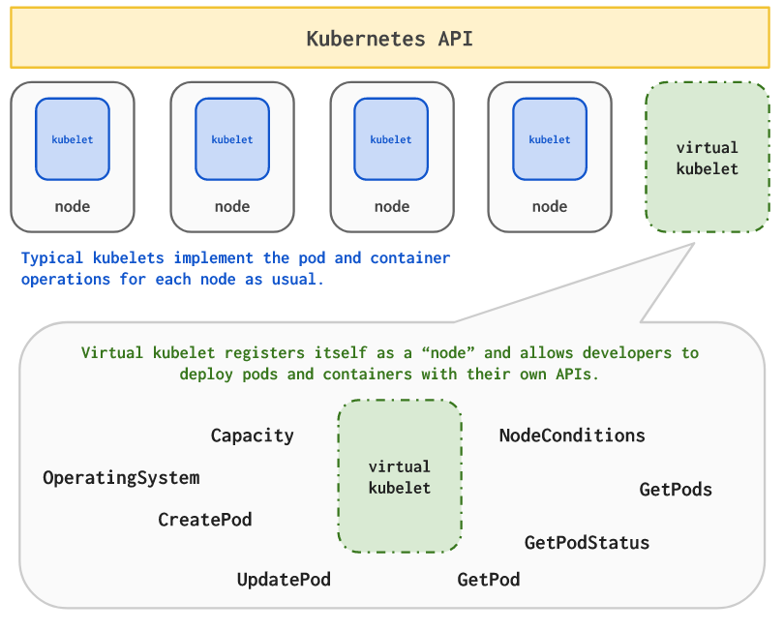
Virtual Nodes – Serverless Kubernetes
ACI – Azure Container Instance

Slide 11
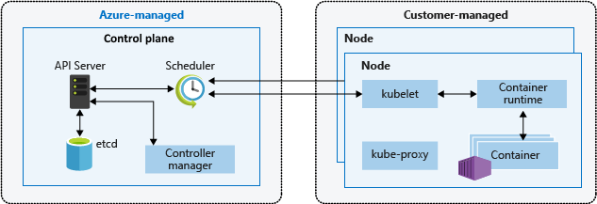
AKS Cluster Archicteture

Slide 12
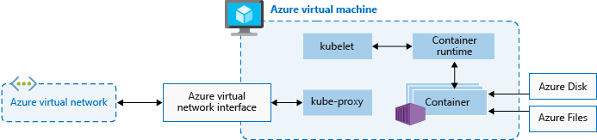
AKS Azure VNet integration

Slide 13
Demos

Slide 14

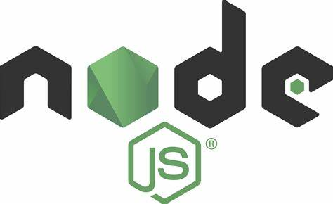

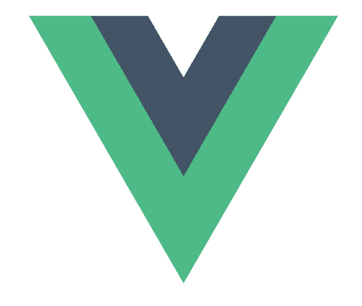




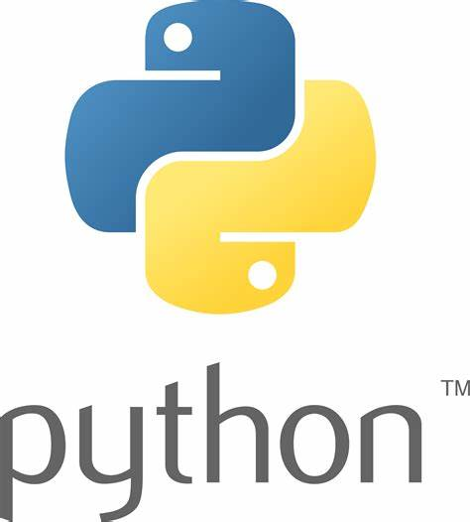

Pet supply store demo
order-service
Order Queue
store-front
Customers
product-service
store-admin
makeline-service
Order Database
Employees
ai-service
Chat Completion

Slide 15
AKS Deployment

Slide 16
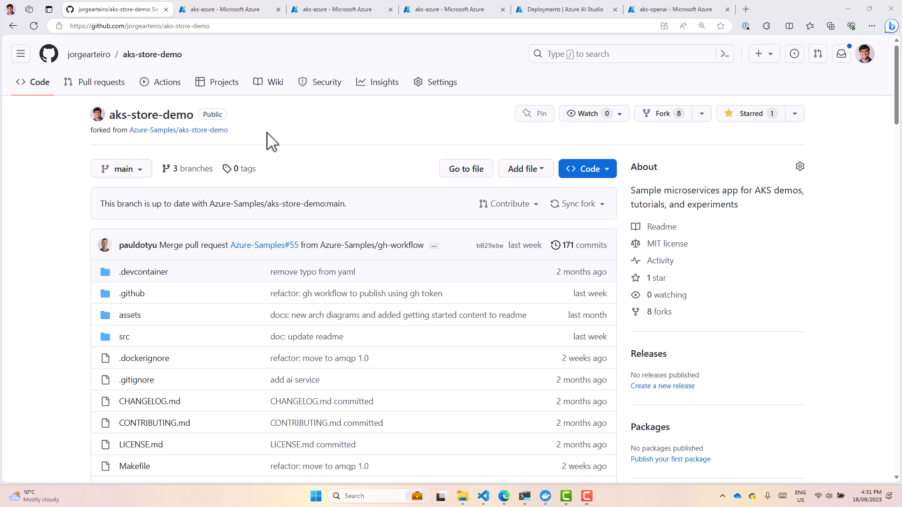


Slide 17
AKS Scaling

Slide 18
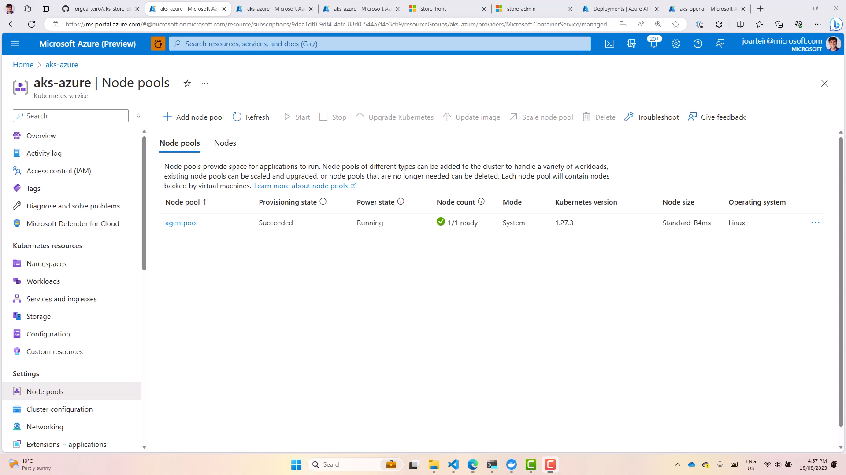

Slide 19
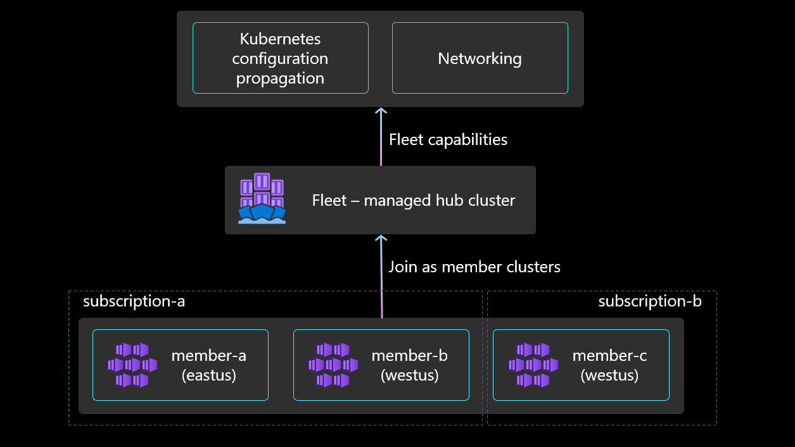
Azure Kubernetes Fleet Manager

Slide 20
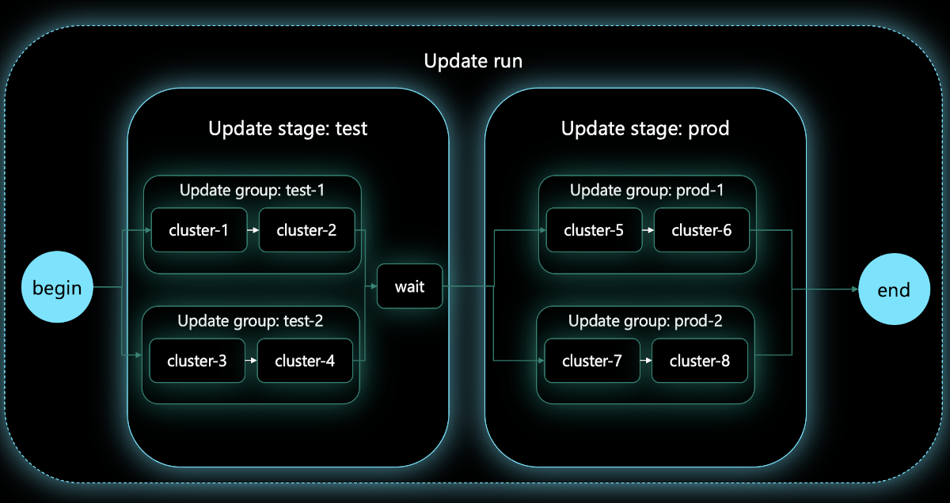
Update Orchestration

Slide 21
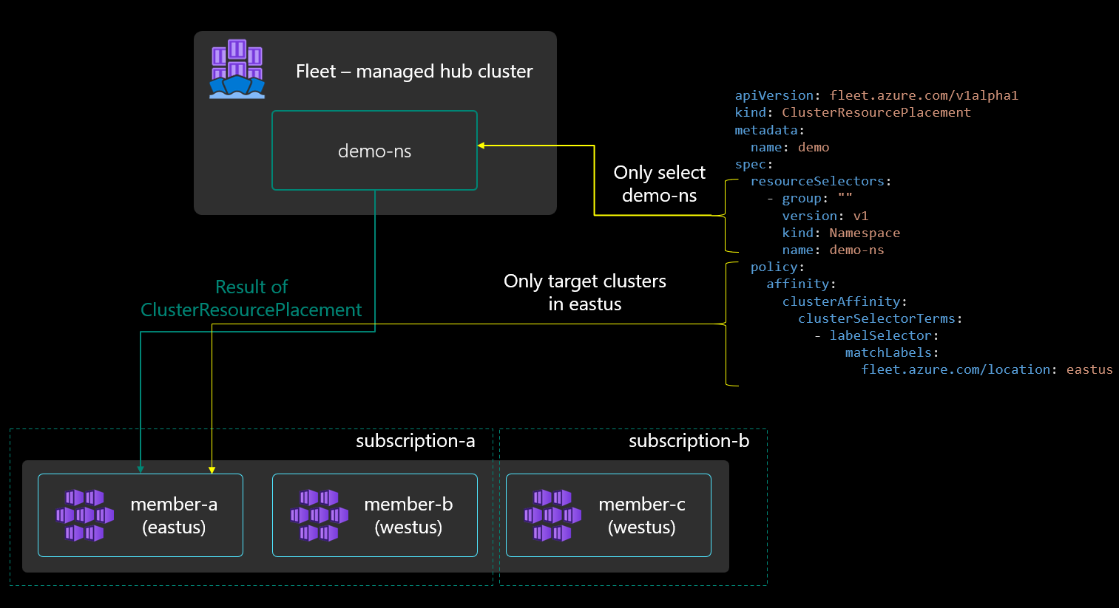
Resources Propagation

Slide 22
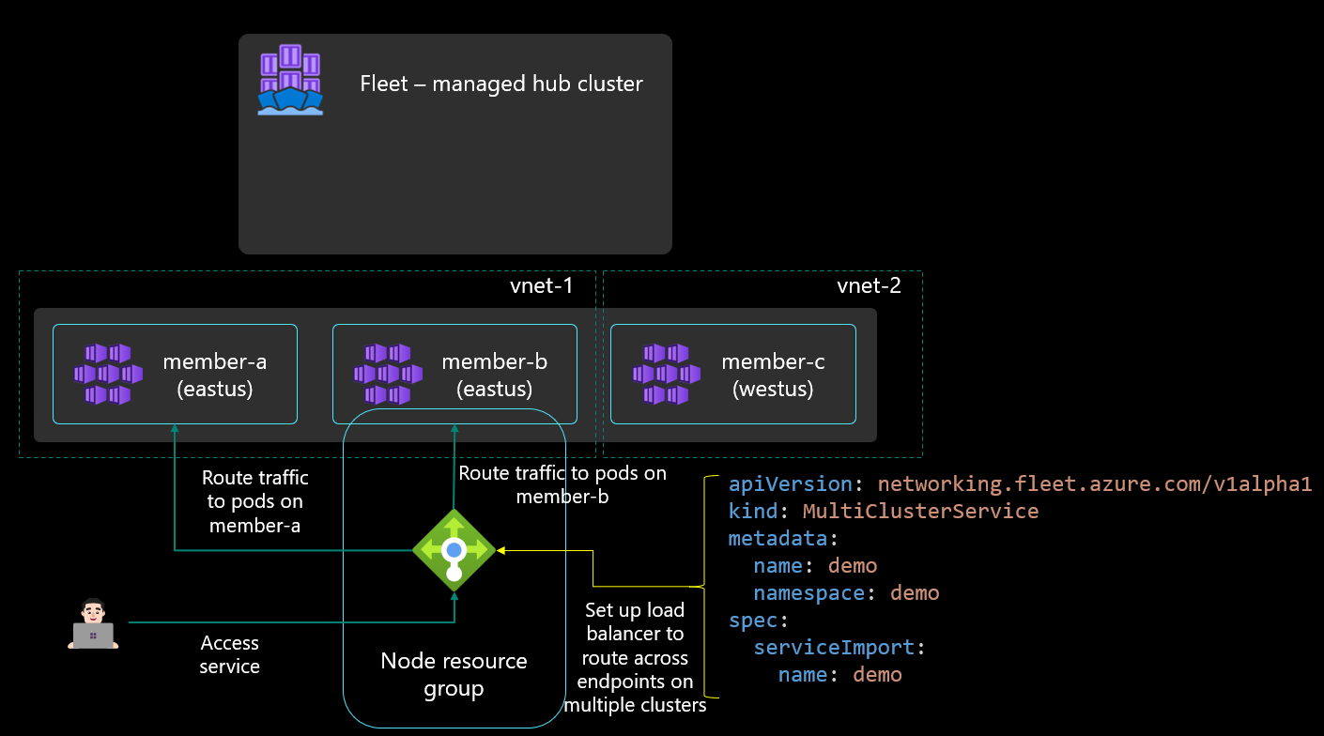
Multi-cluster load balancing

Slide 23
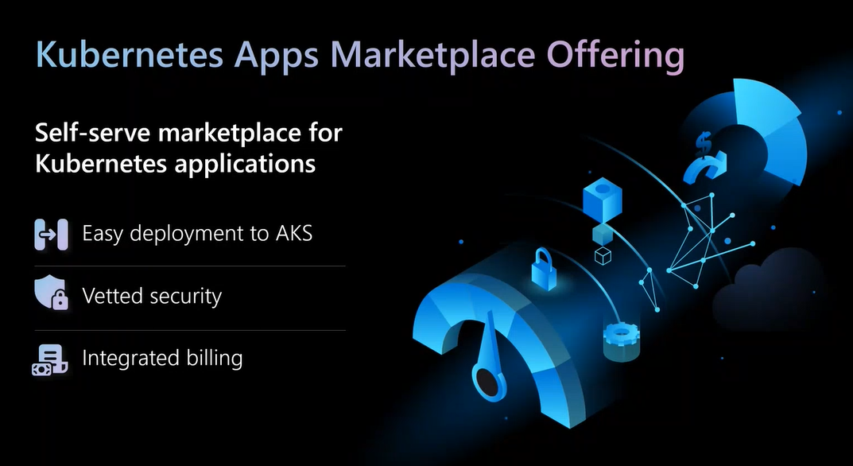

Slide 24
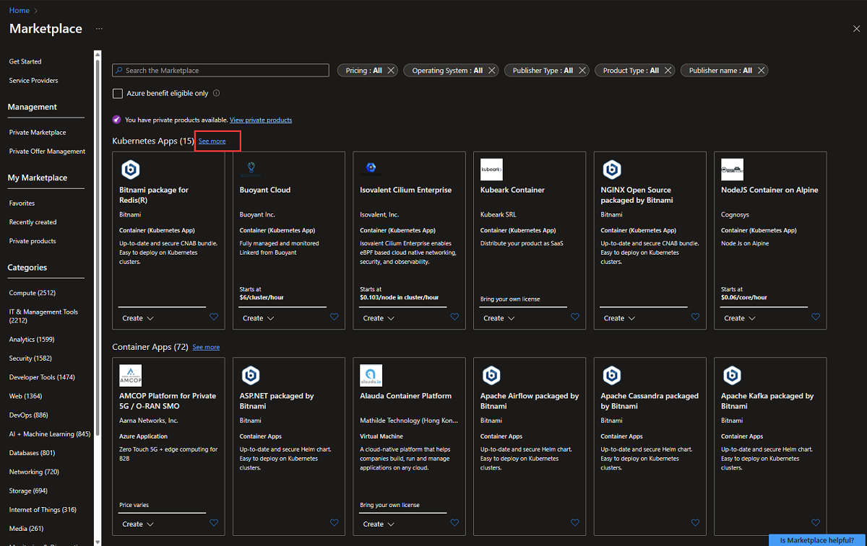

Slide 25
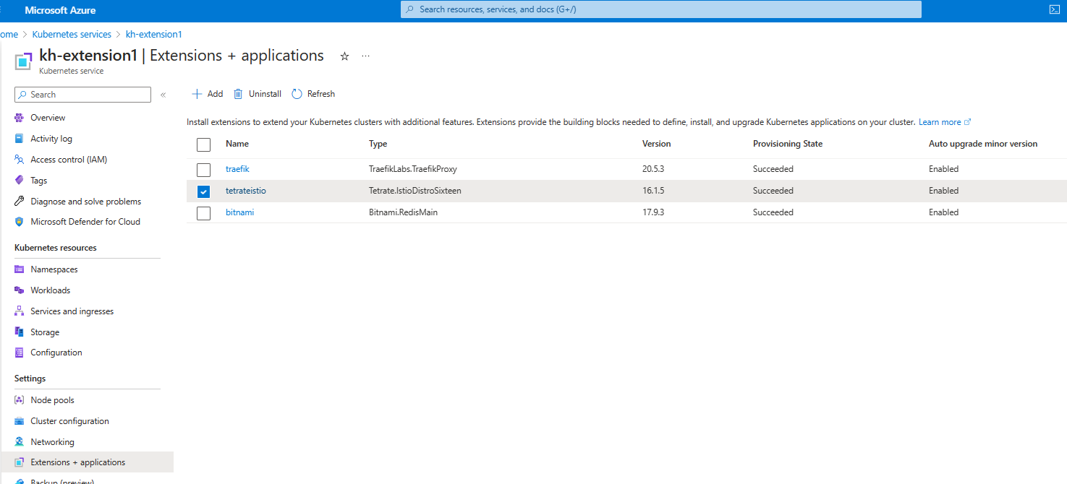

Slide 26

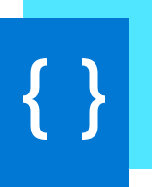


Build cloud native apps anywhere, at scale
Uniformly deploy, configure and manage containerized applications across multiple locations
Azure Management
(Azure Resource Manager, Azure Policy, Azure Portal, API, CLI…)
Bootstrap new locations to fully run with the applications and configuration required
Enable IT to apply and monitor at scale governance
Monitor the state of applications and configuration in all locations with a unified view in the Azure Portal
GitOps-based model for deploying configuration as code to one or many clusters
Developer tooling agnostic— use the tools they want
Notes:
Azure Arc enabled Kubernetes can organize and view all your clusters in Azure and you can also configure them uniformly via called zero touch configuration. This practice is called GitOps, which is a Kubernetes operating model.
In GitOps, the configurations are declared and stored in a Git repo and Azure Arc agents running on the cluster continuously monitor this repo for updates or changes and automatically pulls down these changes to the cluster.
This in turn enables safe deployment practices as the agents ensure that the cluster conforms to the ‘desired state’ as declared by the organization. Any deviation from this desired state will result in an automated rollback.

Slide 27
GitOps – Definition & Principles
Git as the source of truth for a system
Git as the single place where we operate
(create, change, and delete)
All changes are observable
System state described declaratively
State declaration versioned in source control
Approved changes are applied automatically
Agents enforce desired state
https://www.weave.works/technologies/gitops/
Notes:
Azure Arc-enabled Kubernetes adopts a GitOps methodology, so customers define their applications and cluster configuration in source control. This means changes to apps and configuration are versioned, enforced, and logged across any number of clusters.
Let’s explore some of the principles of GitOps :
Single source of truth – Git
All actions taken by developers/admins – create, change and delete happens in Git
All changes are visible to project teams and can be tracked
Declarative Configuration: All resources managed through a GitOps process must be expressed declaratively.
Version controlled, immutable storage: The declarative descriptions are stored in a repository that supports immutability, versioning and version history. For example, git.
Automated delivery: Delivery of the declarative descriptions, from the repository to runtime environment, is fully automated.
Software Agents: Reconcilers deploy and maintain the resources described in the declarative configuration. Actions are performed on divergence between the version controlled declarative configuration and the actual state of the target system.

Slide 28


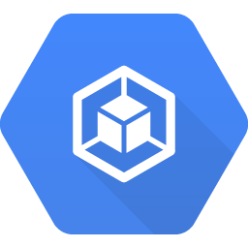
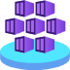




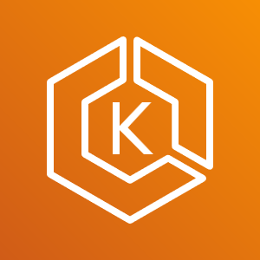
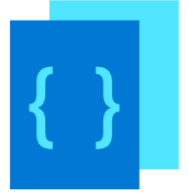


Azure Arc-enabled Kubernetes GitOps Flow
Arc Connected
Kubernetes Cluster
GitOps
Configurations
Flux Operator +
Helm Operator
4
git
Repository
1
2
3
Google Kubernetes
Engine (GKE)
Flux
pickup changes
Application
Rolling Update
Azure Kubernetes Service on HCI
8
7
Application
Deployment
git merge
5
6
Elastic Kubernetes Service (EKS)
Application V2
(New Desired State)
Application V1
(Desired State)
Application
Changes
Rancher K3s
Any Kubernetes,
any Infrastructure
Notes:
So what does the GitOps flow look like in the context of Arc-enabled Kubernetes?
We are starting with Kubernetes clusters outside of Azure
Azure Arc Kubernetes connected cluster is created
User creates cluster’s GitOps configurations
Flux operator gets deployed on the cluster, and starts ”listening” to the git repository with the user’s application code
Flux operator initiates user’s application deployment on the cluster, representing the current desired state
User is updating the application (creating a new app version) and merge changes to the repository
Flux pickup a change to the git repository
Flux operator initiates a new user’s application version deployment on the cluster while removing old version application pods, resulting in a new Desired State

Slide 29

Q&A

Slide 30
Reference

Slide 31

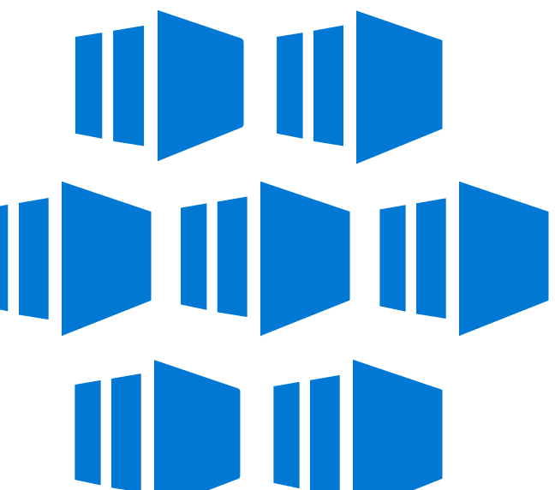






Best support for your enterprise needs
Container Adoption Best Practices aka.ms/adopt/containers
Kubernetes on Azure aka.ms/K8sonAzure
Learning path aka.ms/LearnKubernetes
What is Kubernetes aka.ms/k8sLearning
Hear from experts aka.ms/AKS/videos
Case studies aka.ms/AKS/casestudy
See what’s new aka.ms/k8sroadmap
Try for free aka.ms/AKS/trial

Slide 32
Other References
https://www.slideshare.net/JorgeArteiro
https://azure.github.io/AKS-Construction
https://www.the-aks-checklist.com/
https://learn.microsoft.com/en-us/azure/architecture/reference-architectures/containers/aks/baseline-aks
Baseline architecture for an AKS cluster - Azure Architecture Center | Microsoft Learn
Azure Kubernetes Fleet Manager architectural overview | Microsoft Learn
https://github.com/jorgearteiro/dotnetdemo
https://github.com/Azure-Samples/aks-store-demo
https://github.com/marketplace/actions/deploy-to-azure-container-instances
https://learn.microsoft.com/en-us/connectors/aci/
jorgearteiro/awesome-compose: Awesome Docker Compose samples (github.com)
Deploying Docker containers on Azure
ACI integration container features (docker.com)
ACI integration Compose features (docker.com)
jorgearteiro/virtual-node-autoscale: A sample application to demonstrate Autoscale with AKS Virtual Nodes (github.com)
https://aka.ms/AzureContainerApps
https://github.com/Azure-Samples/aci-logicapps-integration
(7) Serverless containers with Azure Container Instances (ACI) | Azure Friday – YouTube
https://www.youtube.com/watch?v=giQLmxMKAKE

